Slide 1
CITI Program
for Faculty of Medicine,
Chiang Mai University
A guide for registration and course selection

Slide 2
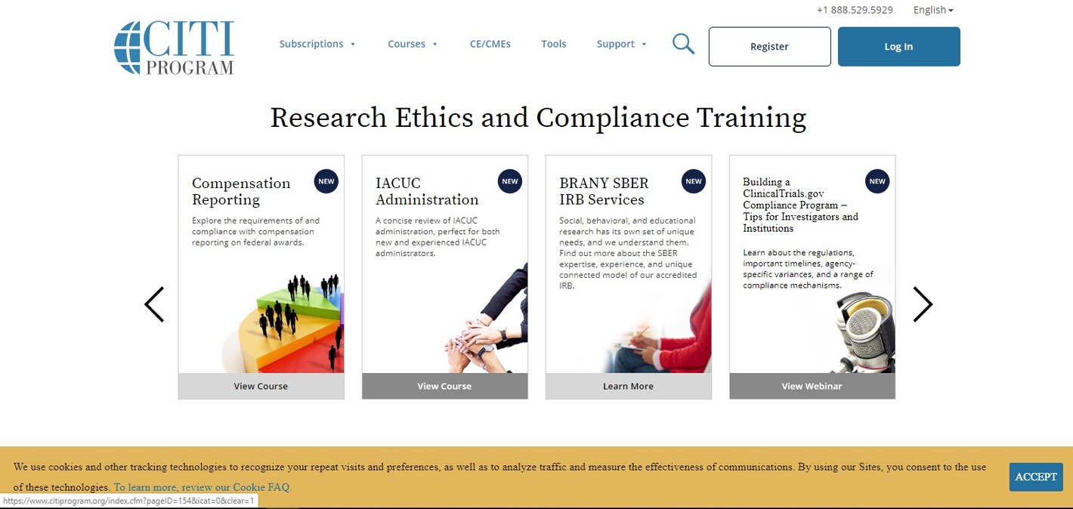
Who can register to CITI Program course ?
CMUFM Staff
CMUFM Student
*CMUFM-Chiang Mai University, Faculty of Medicine

Slide 3
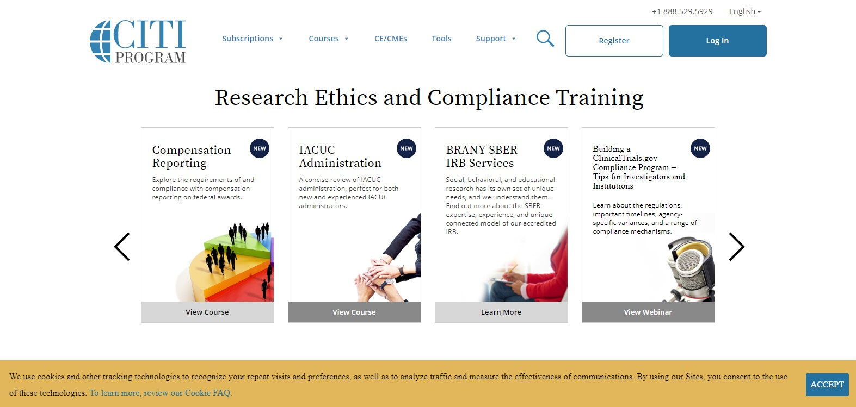
Registration
1. https://about.citiprogram.org/en/homepage
-Click Register
1

Slide 4
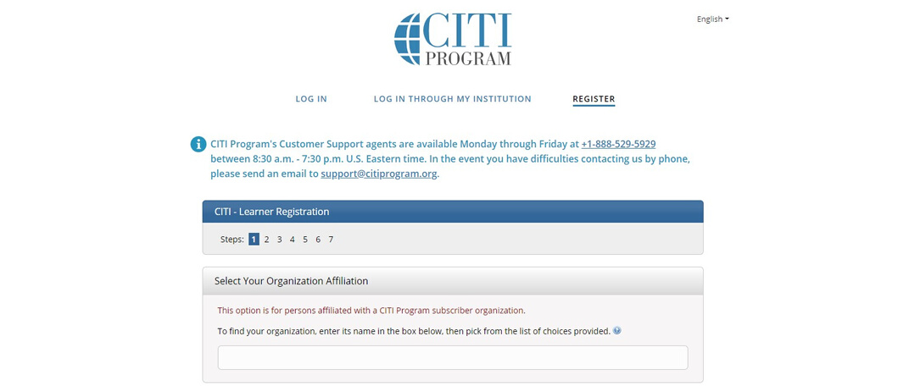
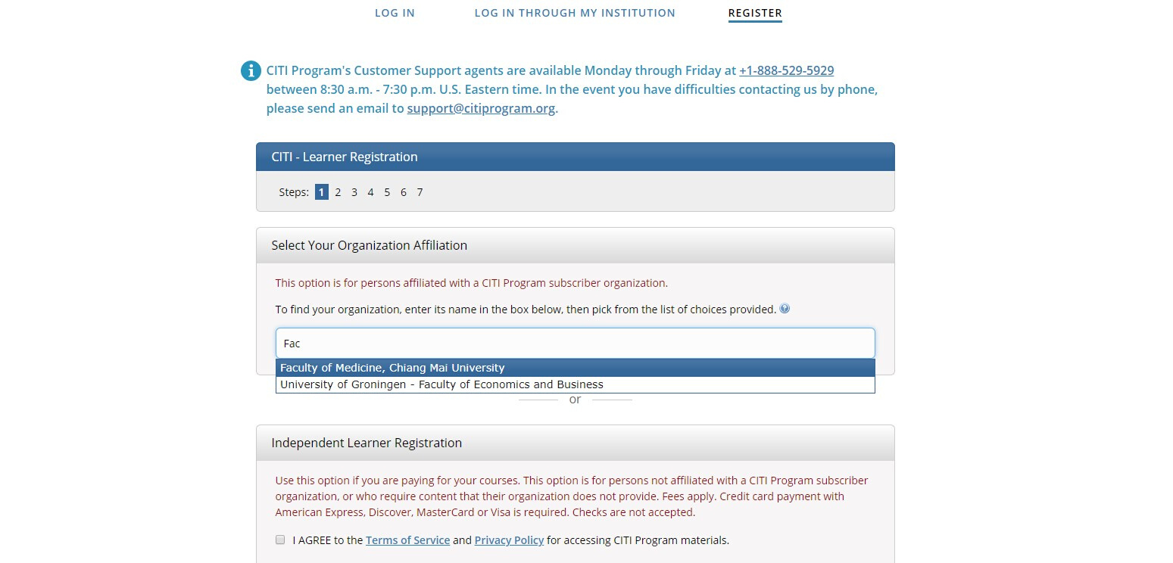
Registration
2. Select your Organization Affiliation
-Type "Faculty of Medicine, Chiang Mai University "
2

Slide 5
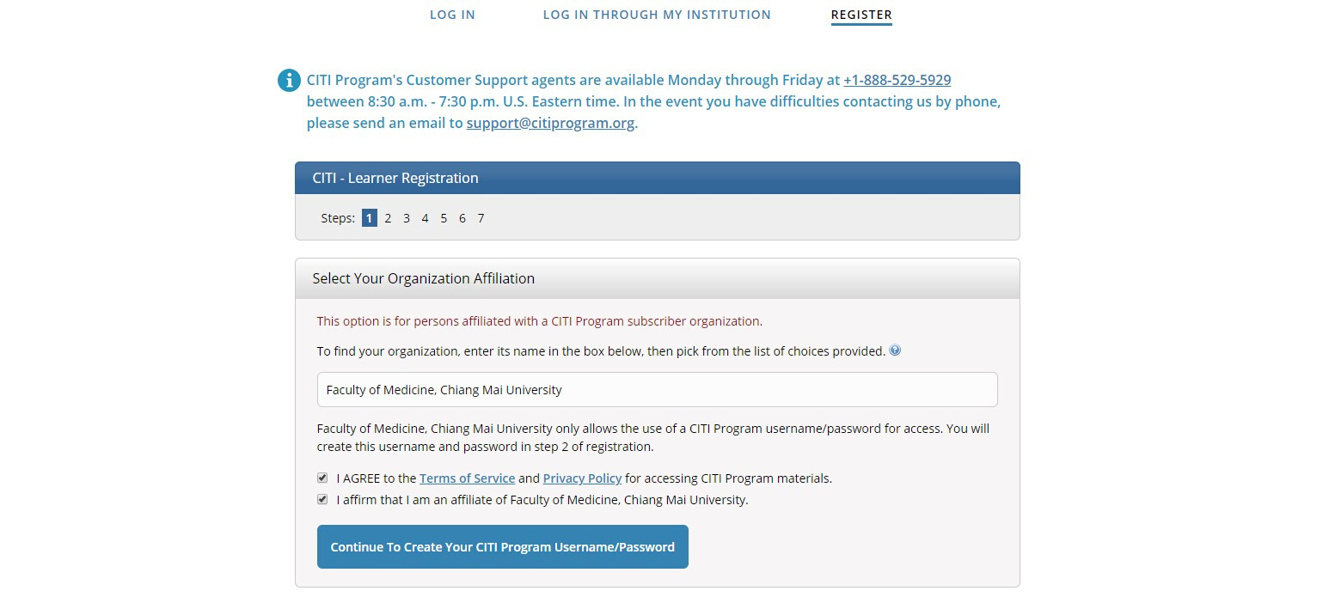
Registration
3. Check Agreement and affirm affiliation
- Click continue to create your CITI Program Username/Password
3

Slide 6
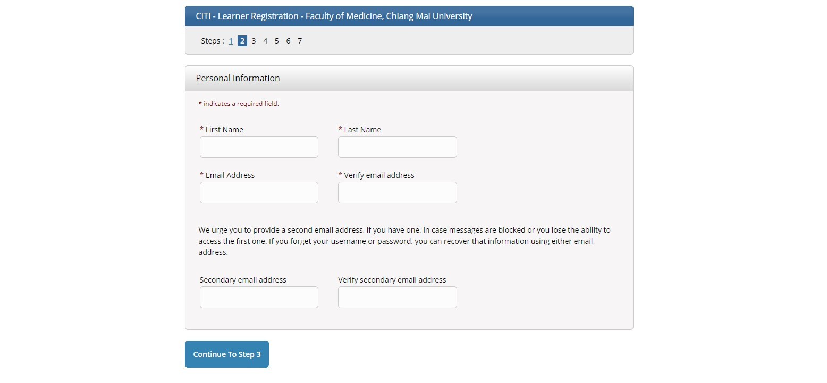
Registration
4. Fill you personal information
- Click "Continue to Step 3"
4

Slide 7
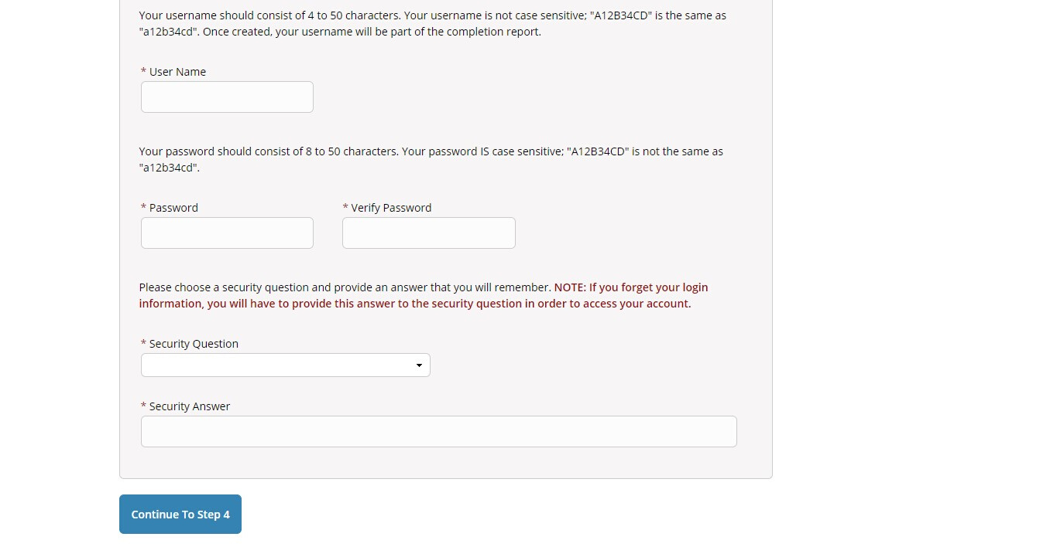
Registration
5. Create your username and password
- Click "Continue to Step 4"
5

Slide 8
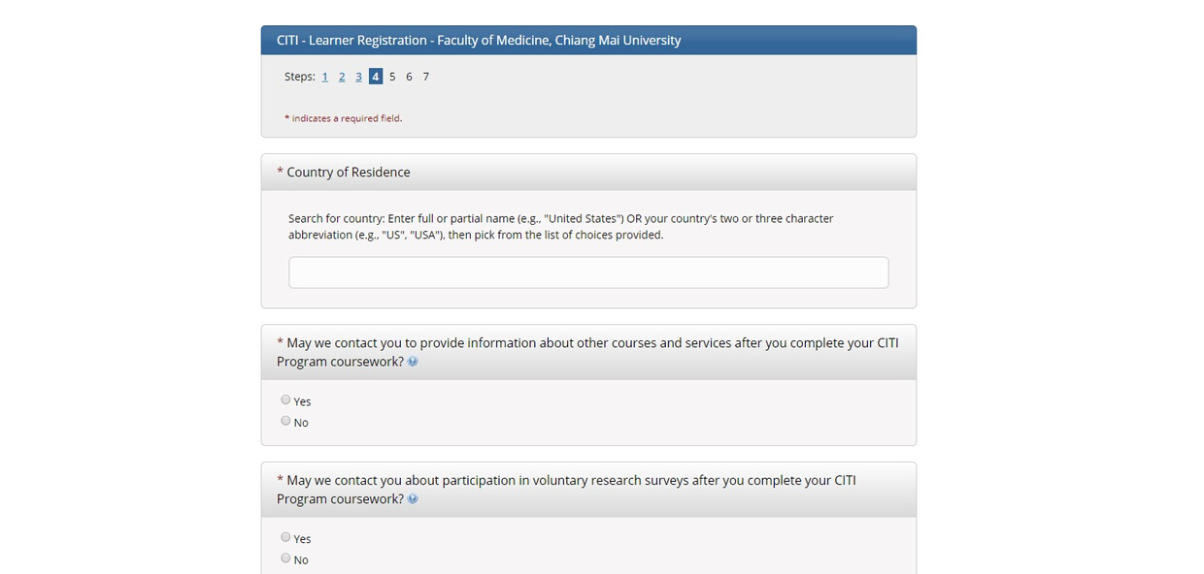
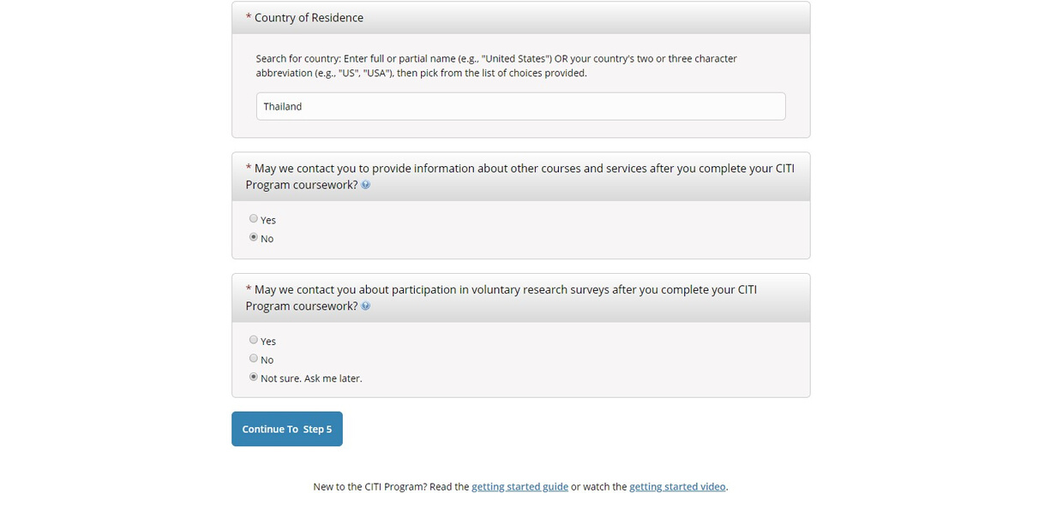
Registration
6. Fill more information
- Click "Continue to Step 5"
6

Slide 9
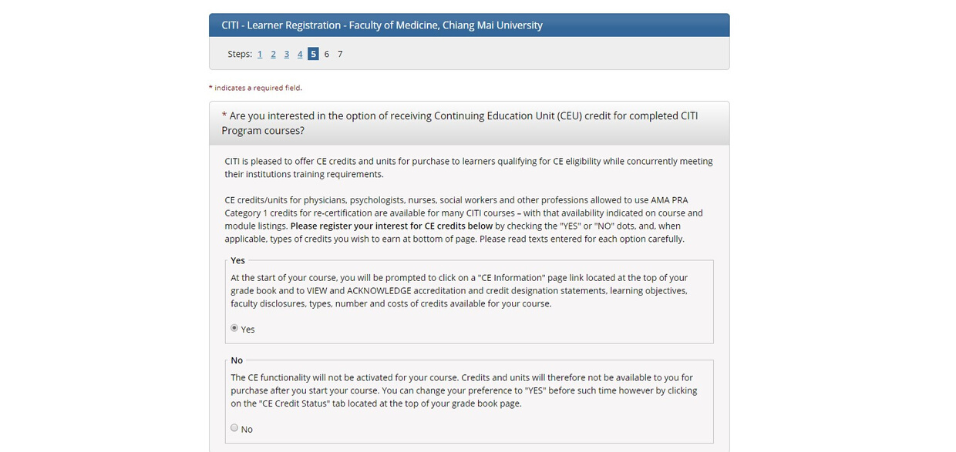
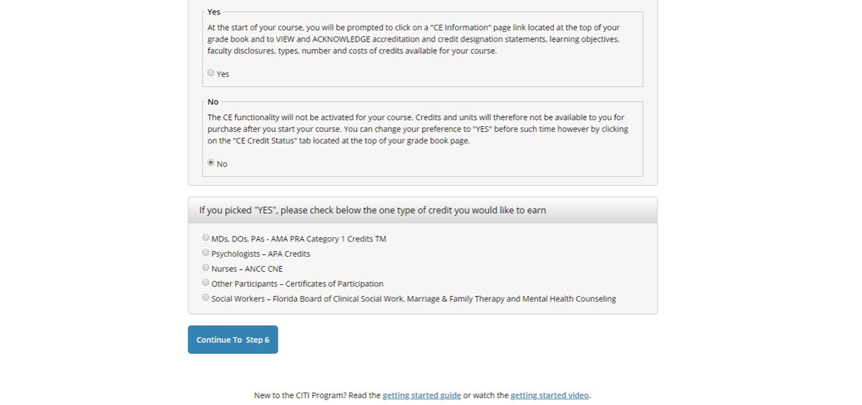
Registration
7. Fill more information
- Choose “NO” for CEU
- Click "Continue to Step 6"
7

Slide 10
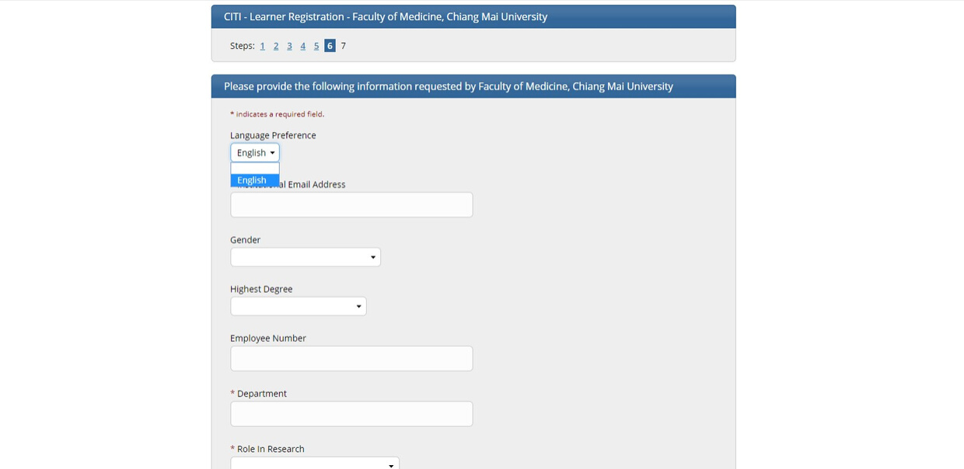
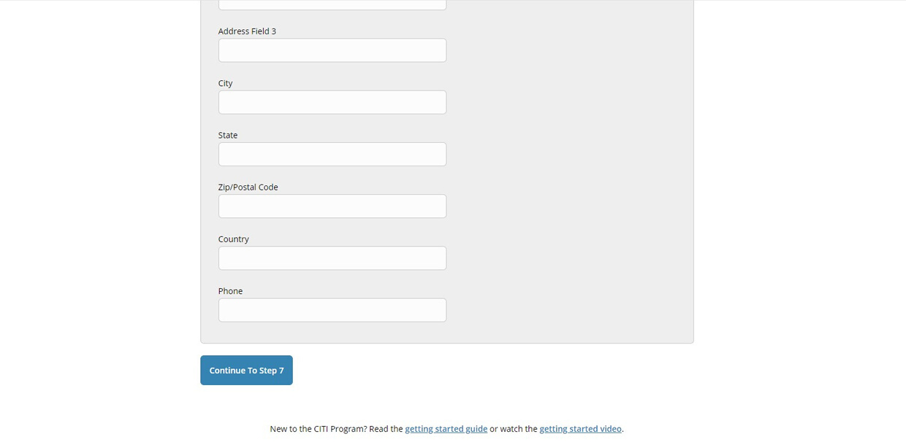
Registration
8. Choose your language preference and fill more personal information
- Click "Continue to Step 7"
8

Slide 11
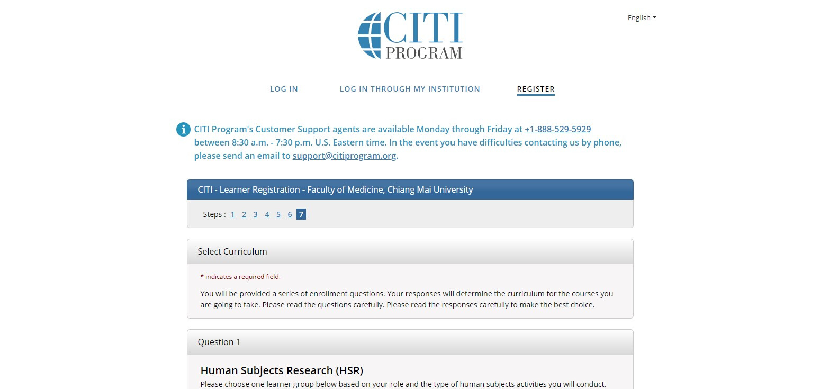
Registration
9. Select Curriculum by answer the Questions.
9

Slide 12
HOW TO SELECT YOUR COURSE

Slide 13
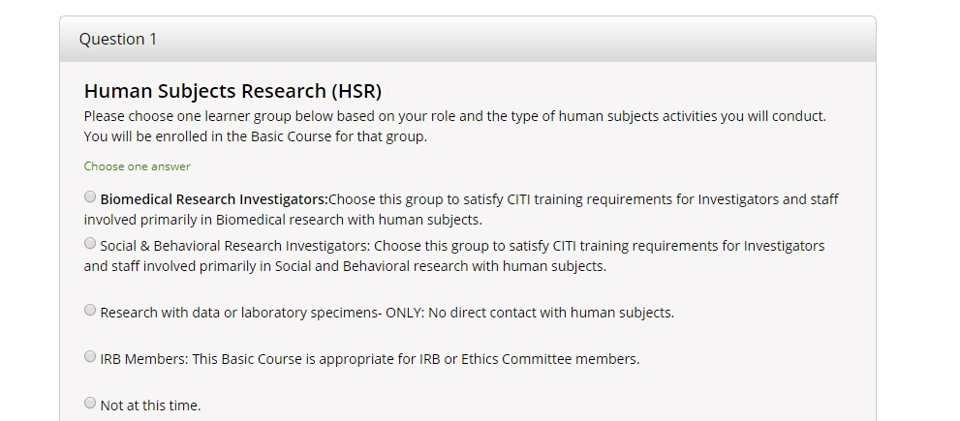
Course selection
Answer the question 1-11 to select courses.
Subjects matching learner groups are shown in Appendix I
Question 1 for Human Subjects Research (HSR)

Slide 14
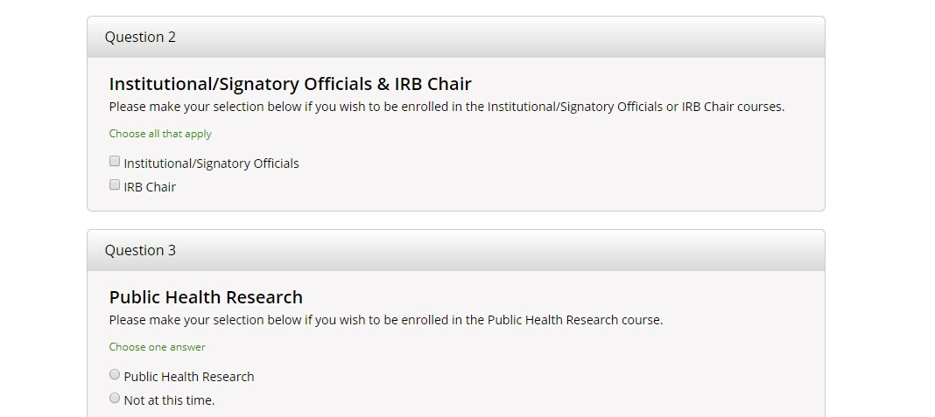
Course selection
4. Question 2 for Institutional/Signatory Officials & IRB Chair.
5. Question 3 for Public Health Research

Slide 15
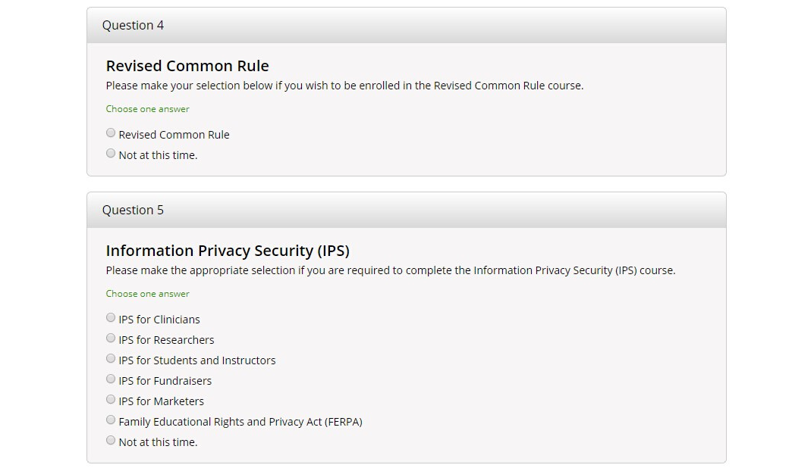
Course selection
6. Question 4 for Revised Common Rules
7. Question 5 for Information Privacy Security (IPS)

Slide 16
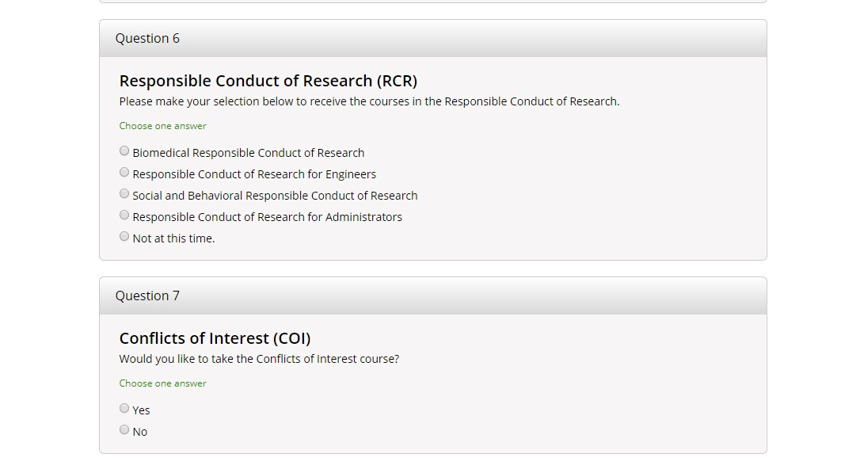
Course selection
8. Question 6 for Responsible Conduct of Research (RCR)
9. Question 7 for Conflict of Interest (COI)

Slide 17
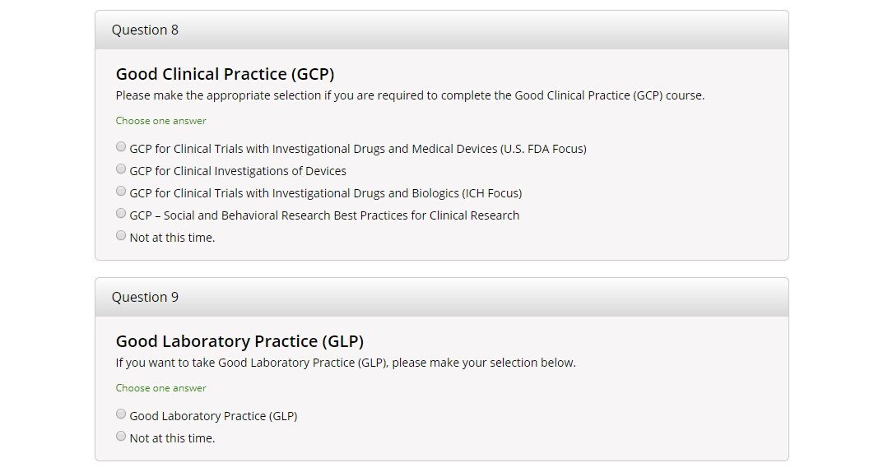
Course selection
10. Question 8 for Good Clinical Practice (GCP)
- Choose GCP for Clincal Trails with Investigational Drugs and Biologics (ICH Focus)
11. Question 9 for Good Laboratory Practice (GLP)

Slide 18
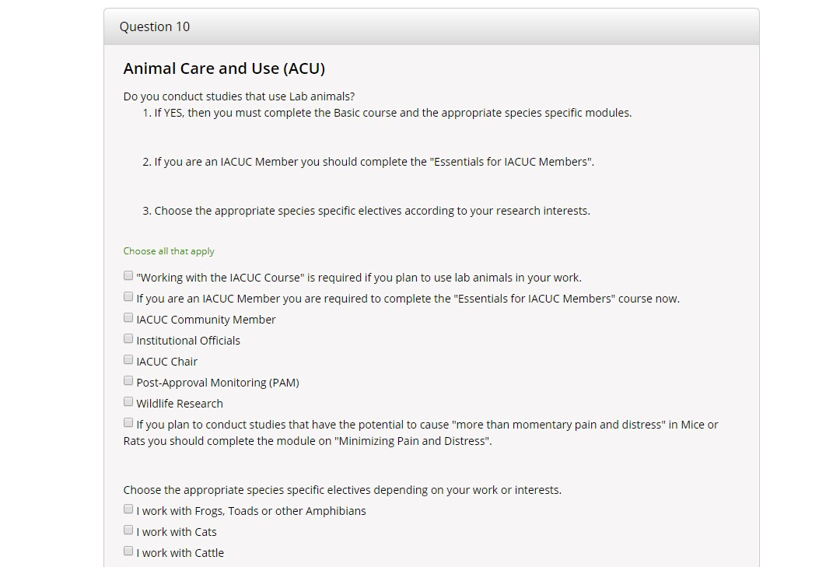
Course selection
12. Question 10 for Animal Care and Use (ACU)
- Choose "Working with the IACUC Course" is required if you plan to use lab animals in your work and Choose the appropriate species specific electives according to your research interests.

Slide 19
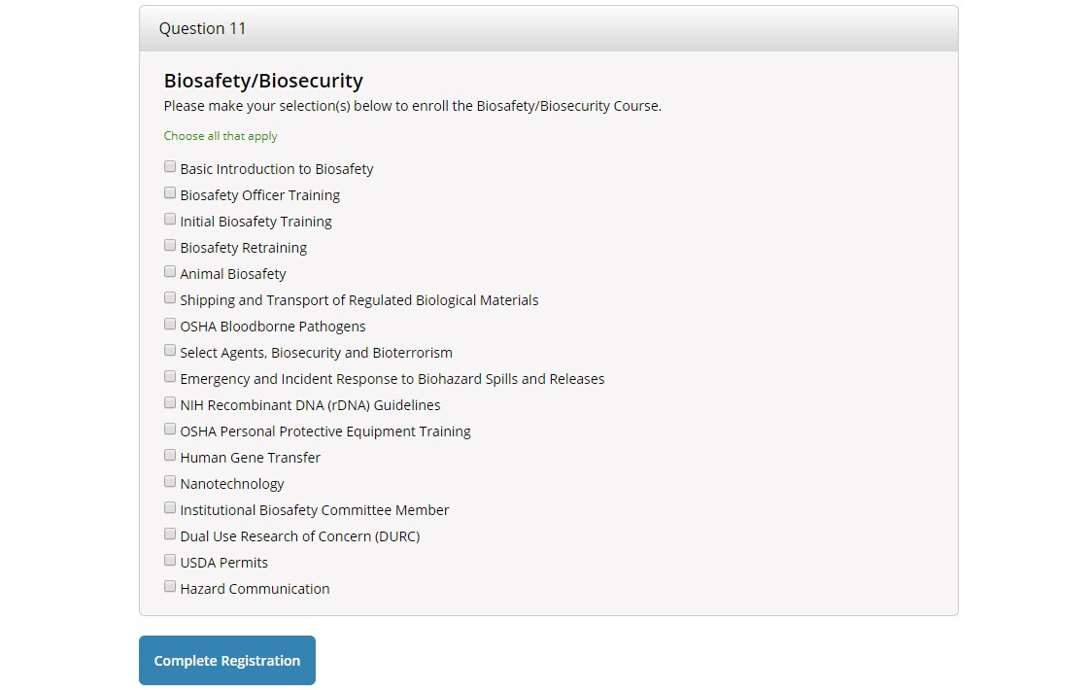
Course selection
13. Question 11 for Biosafety/Biosecurity
- Choose Basic Introduction to Biosafety and Animal Biosafety for basic requirements of the course.
14. Click "Complete Registration".

Slide 20
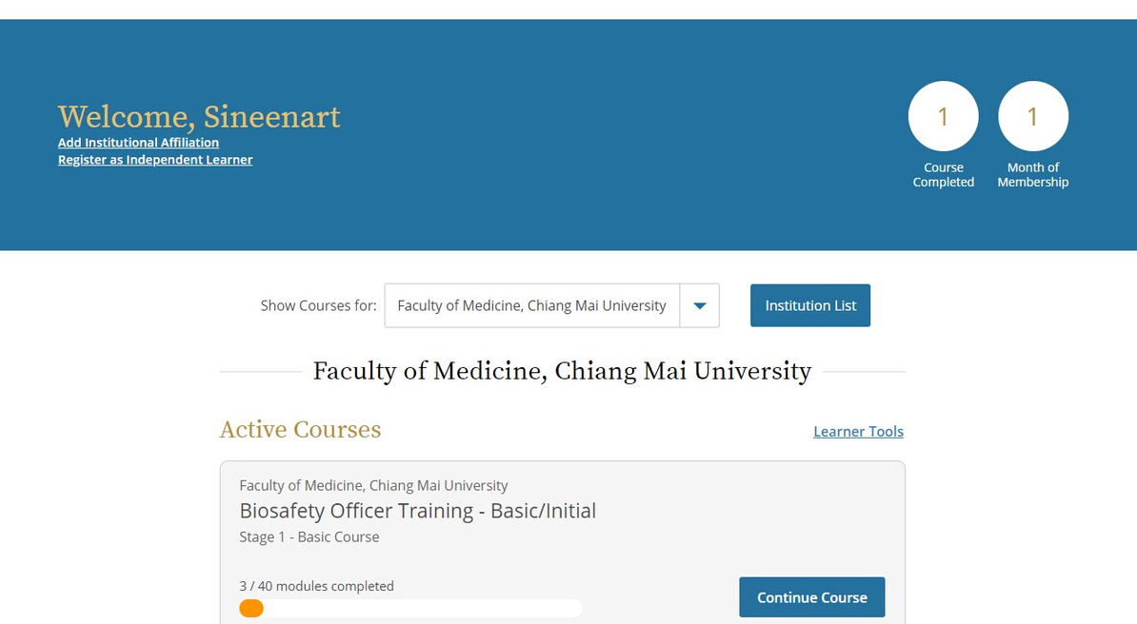
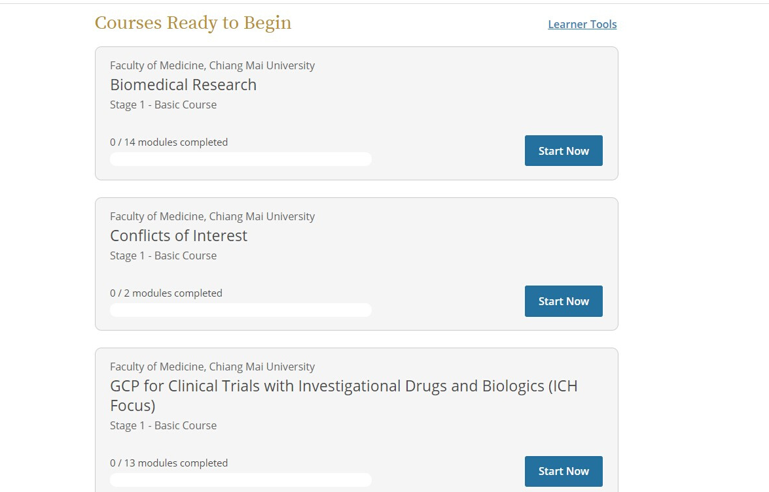
NAME
Course completion
1. Your selected courses are shown in your loged in page
- Click "Start Now" for Courses Ready to Begin.
- Click "Continue Course" for Active Courese.

Slide 21
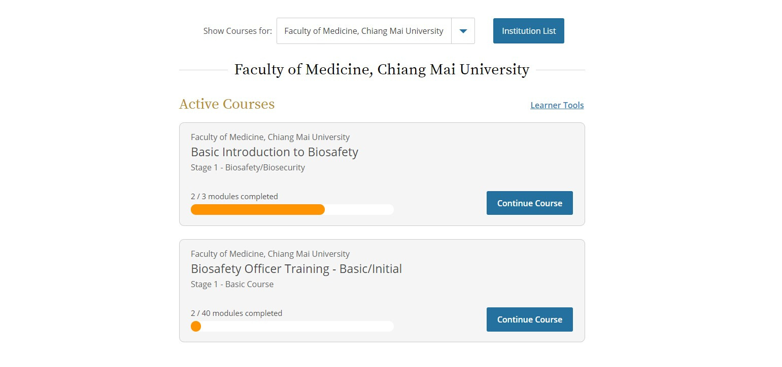
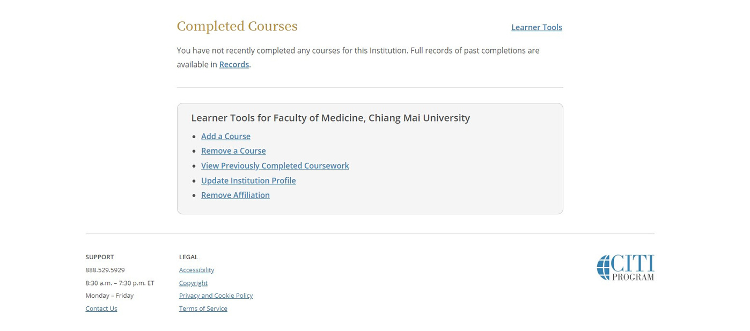
Course completion
2. Your Active Courses divided into modules depend upon its contents.
- Click "Continue Course" in each module.

Slide 22
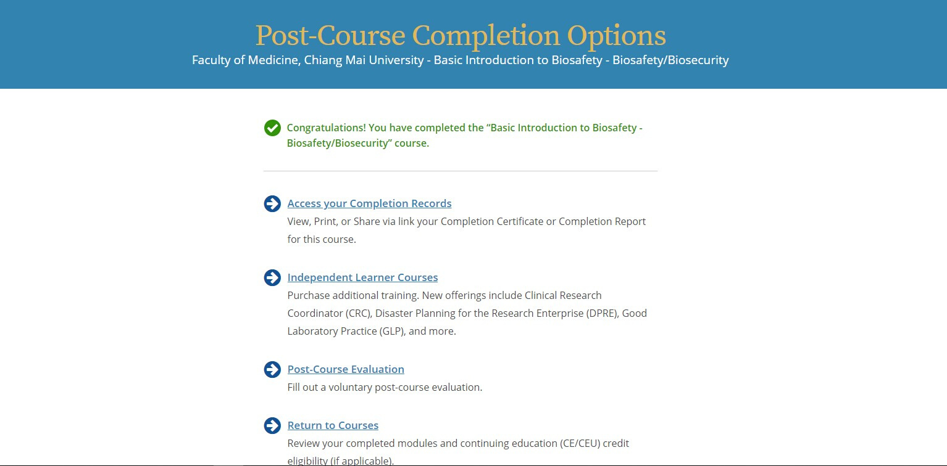
Post-Course completion
1. Post-Course Completion Options
- Click "Access your Completion Records" to view, print or share via link your Completion Certificate or Completion Report of the course.

Slide 23
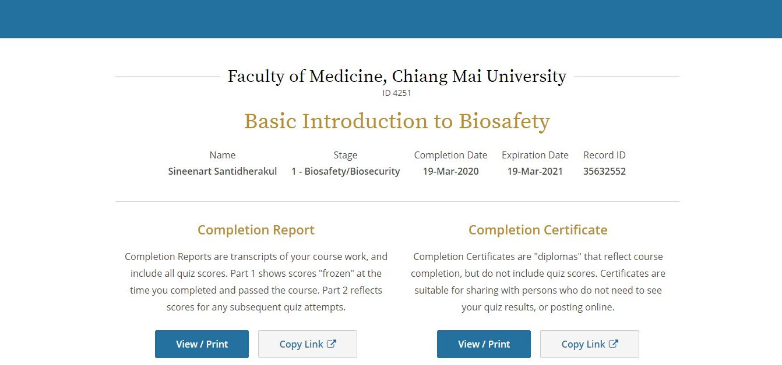
NAME
Post-Course completion
2. View, Print or Share your course certificate or report.
- Click "View/Print" or "Copy link" to view/print or share via link your Completion Certificate or Completion Report of the course.

Slide 24
NAME
Post-Course completion
3. Your Course certificate important information :
- Course' Topic
- Completion Date
- Expiration Date
- Record ID

Slide 25
Course management
1. You can manage your courses anytime by
- Choose "Learner Tools" to Add, Remove, View previously completed course.

Slide 26
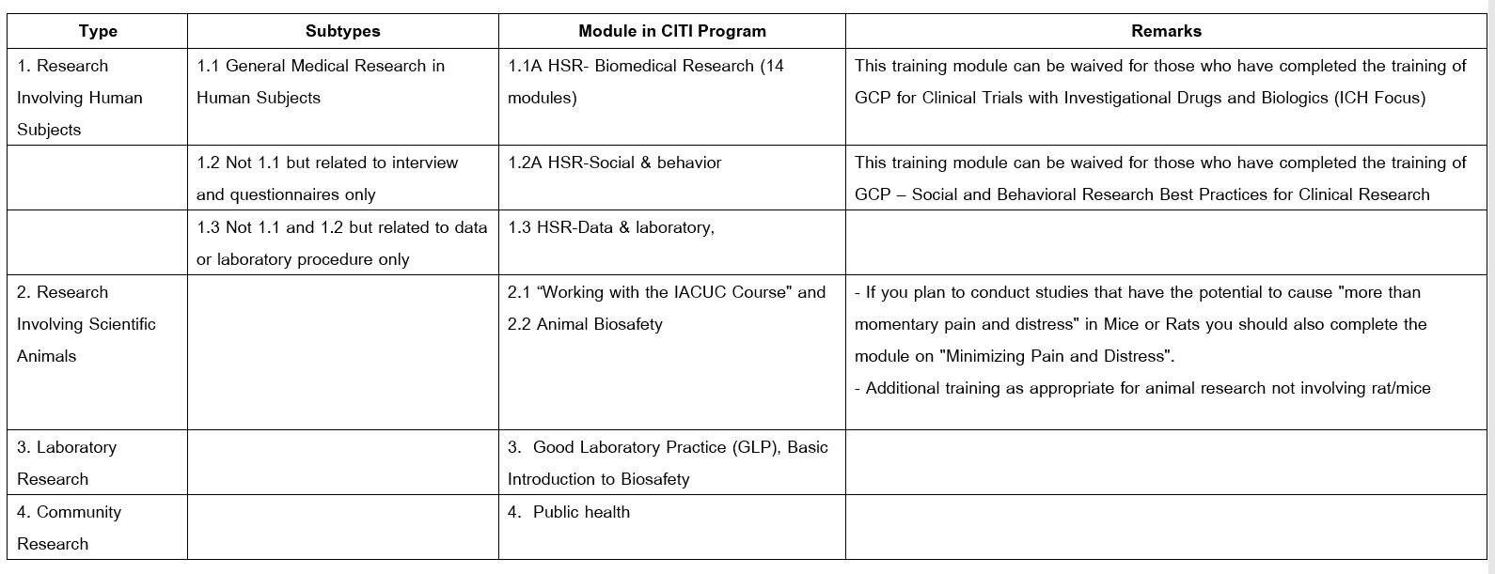
APPENDIX I
Guide Related to the Training Modules of Research Ethics Applied for Researchers of Chiang Mai University
Faculty of Medicine (CMUFM)
CMUFM Researchers* must complete these modules 1. Biomedical Responsible Conduct of Research Module and 2. Conflict of Interest Module.
In addition, CMUFM Researchers must complete the following modules that are relevant to their research types.
*Researchers are those conducting research and/or those with an intention to publish their works in academic journals.

